Slide 1
Jacob Summer Update III
Hopping

Slide 2
Overview
To build a dynamic robot capable of balancing and hopping
Incorporate force measurement device
Begin with hopping 2dof leg
Use simulation to inform design

Slide 3
Literature – R.S. Fearing
Cockroach-inspired self-righting
Began with dynamic righting of actuated wing
Faster and larger pitch better
Then quasi-static righting of slowly actuated wing
Fixed L and D
Varied height
Taller is better
Then passive righting of fixed wing
Higher change in energy
Cockroaches right dynamically
Turtles right passively with highly domed shell

Slide 4
Literature – R.S. Fearing
Mechanical Power Modulation
Maximize “agility”
Agility = jump height * jump frequency
Sought to maximize jump height for monopedal hopping
Low mechanical advantage when compressed, high mechanical advantage through stroke
Experimental setup
Linear slide to stabilize and hopping on force sensor
Started in compressed state
Used larger Pololu motor

Slide 5
Tasks
Use Unity to:
Model spring, joints, and contact
Collect data
Respond to feedback and actuate mechanism
Enable interaction
Build simulation of leg
Use simulation to:
Select leg dimensions
Determine spring characteristics
Select motors
Manufacture first prototype
Design harness
Manufacture harness
Write vertical hopping code
Test code in simulation
Test hopping with actual leg

Slide 6
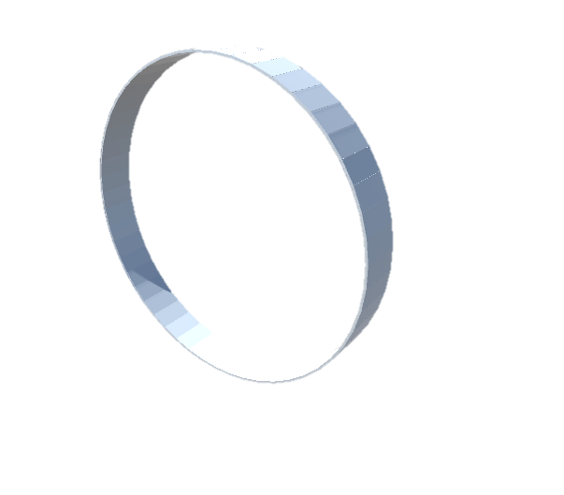

Progress
Modeled body shape
Teardrop: y = cos(t); x = sin(t)(sin(t/2))^c;
c = 0
c = 0.5

Slide 7
Progress
Current motor can’t jump at all
Build analytical model of jumping velocity to match motor

